Slide 1

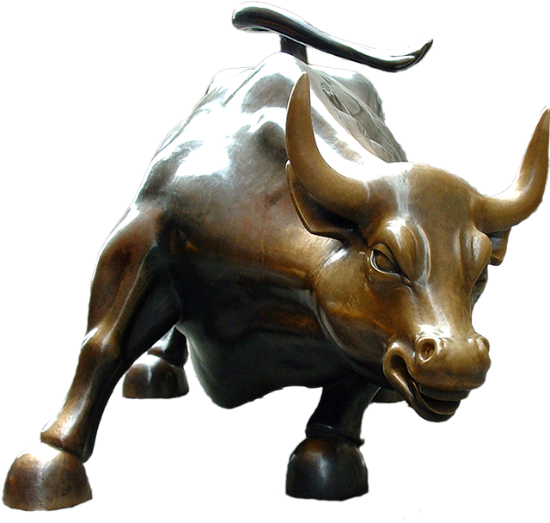
Natural Language Processing & Financial Applications
GROUP 9
JORDAN BICKELHAUPT
EVELINA RAMOSKAITE
DAVE SAWH
ANDREW SCHIEK
Notes:
Dave: 1-4; Evelina: 5,6,7; Dave: 8; Jordan:9 14 15

Slide 2
Background
More retail traders are entering the market. These traders are driven more by sentiment than traditional financial institutions.
Some companies’ stocks deviate sharply from their fundamental value.
Ex: AMC, Gamestop, Tesla
Social media forums are active with discussions surrounding stocks, especially Reddit and Twitter. These stocks are also known as meme stocks.
We aim to explore the best NLP methods and examine the relationship between sentiment and movements in price.

Slide 3
Objectives
Main Questions:
What is the best method of NLP for Tweets about the stock market?
Can Twitter Serve as a proxy for investor sentiment?
Application:
Apply greatest accuracy NLP technique towards predicting stock movements

Slide 4
Work Flow
Gather Tweets and Historical Price Data
Clean unwanted characters and Tokenize the text
Examine trends in the Twitter data
ML models
Rule-Based Models
Deep Learning ( BERT) Model
Hold-out set with an 80/20 partition
Apply best model to predict the sentiment of stock hashtags
Explore any relationship between sentiment and price movements
Data Scraping / Cleaning
Exploratory Analysis
Model Building
Evaluation
Application

Slide 5
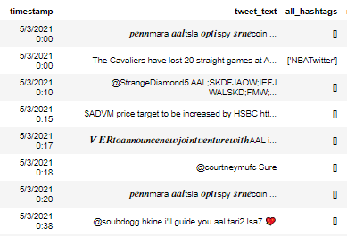
Our Data
We scraped a full day of tweets on May 5th, 20201 for 5 stocks and exchange traded funds: AAL, GME, SPY, WMT, GOOGL
Tweets were sourced using the twitter API and Tweepy python library.
We excluded retweets and non-English content.
The Stock price dataset was sourced using the yahoo finance library.
We got hourly historical price quotes and computed the percent change for each period.
Bert was trained on a separate dataset called the sentiment 140, and then applied to the data we gathered.

Slide 6
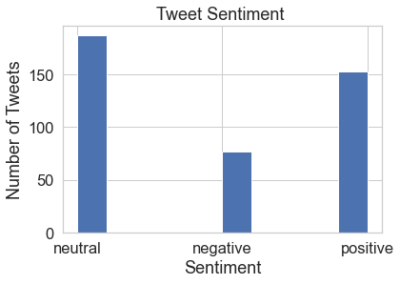
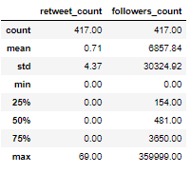
Exploratory Analysis (# GOOGLE)
Most Tweets Were Positive or Neutral
The average user had 6,857 followers, which is high compared to the mean of 707 site-wide.
Retweet counts were low overall, except for users with follower counts > 50K.

Slide 7
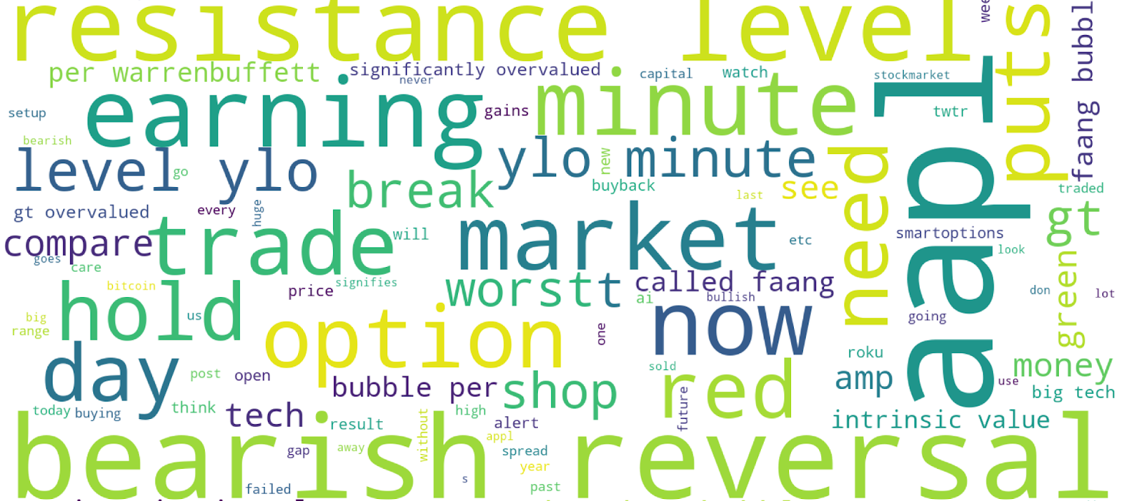
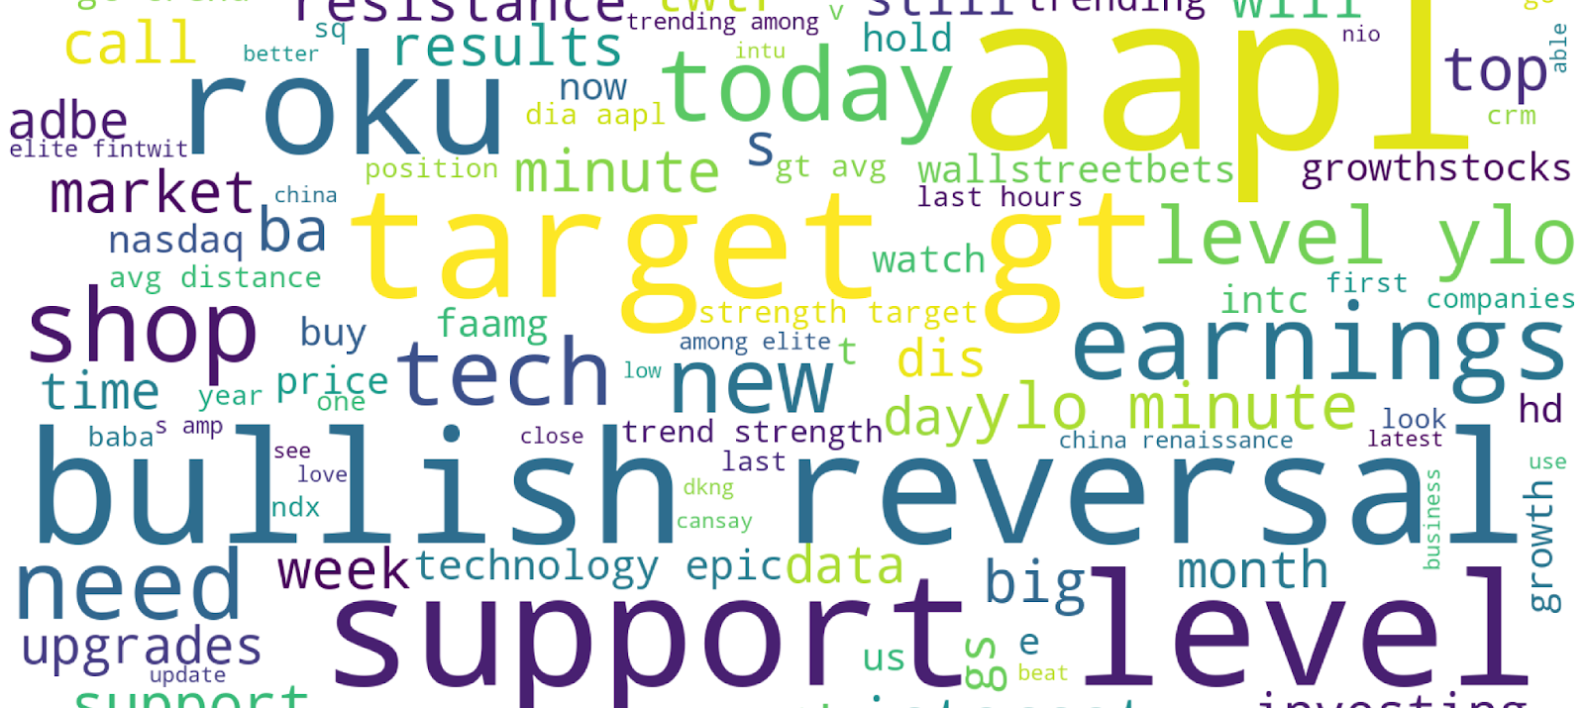
Word Cloud
NEGATIVE- ‘BEARISH REVERSAL’, ‘PUTS', 'STOCK MARKET BUBBLE’, ‘OVERVALUED',' INTRINSIC VALUE’
POSITIVE- ‘BULLISH REVERSAL’, ‘CALLS’,’WALLSTREETBETS’, ‘TARGET’, ‘EARNINGS’,’UPGRADES’,’STRENGTH,’GROWTH’

Slide 8
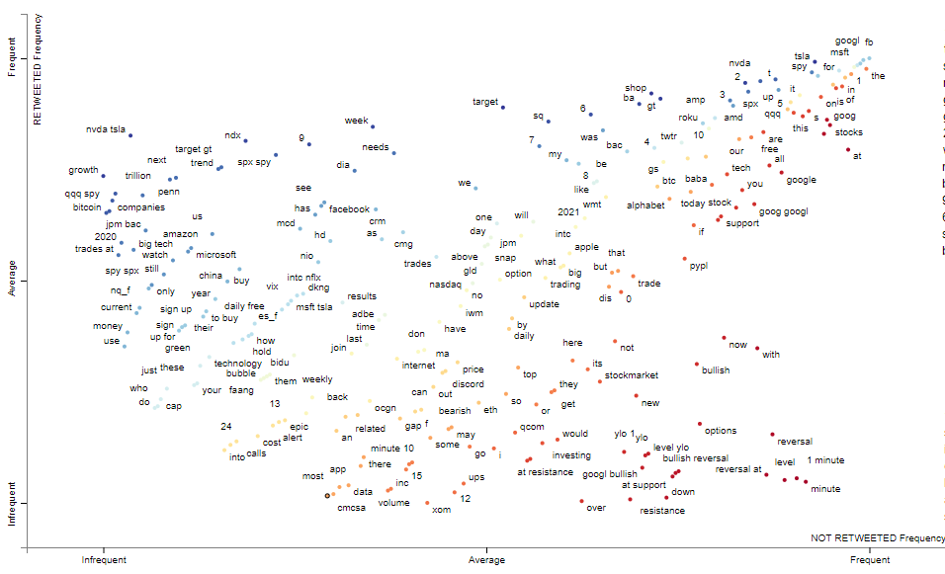
Scattertext
The diagonal shows words that go from less frequent to more frequent. (yellow dots)
Words that appear towards the top are the words that lead to tweets being retweeted(blue dots).
The upper right corner includes words that are the most overlap between being retweeted and not. (red dots)
All in all, one can use this diagram to understand that users are viewing the peers when talking about the single company, and rather focus on the positive tweets about the price going up and ignore the tweets about the price going down or being bullish.

Slide 9
Applied Methods
Lexicon-Based Methods
Vader and TextBlob
Machine Learning Methods
Decision Tree, Random Forest, Logistic Regression, SVM, KNN, MLP
Deep Learning
Google BERT
Notes:
lexicon: pretrained dictionary -- calculates sentiment based on “semantic orientation of word or phrases”
MLP

Slide 10
Model Validation
Overview of Performance on the Test Set
 | Accuracy | Precision | Recall | F1-Score
Bert | 84.0% | NA | NA | NA
Decision Tree | 51.5% | 51.9% | 51.9% | 0.515
Logistic Regression | 72.6% | 72.3% | 72.6% | 0.726
Random Forest | 69.0% | 69.9% | 69.1% | 0.675
RandomForest using Spacy | 69% | 72% | 69% | 0.68
SVM | 67.9% | 68.4% | 67.9% | 0.678
TextBlob | 50.4% | 51.3% | 50.4% | 0.502
Vader | 50.4% | 51.3% | 47.6% | 0.504
XGBoost | 69.1% | 68.7% | 69.1% | 0.688
KNN | 51.2% | 53.43% | 51.19% | 0.475
MLP | 57.1% | 58.1% | 57.1% | 0.557
BERT HAS THE BEST OVERALL PERFORMANCE, 84%
LOGISTIC REGRESSION WAS THE BEST ML MODEL,72.6%
RULES-BASED MODELS HAD THE WORST PERFORMANCE,50.4%

Slide 11
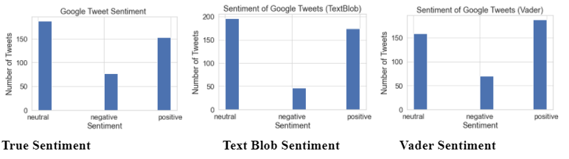
Lexicon-Based Methods
TextBlob and Vader are both lexicon-based methods, their predictions did not adapt from training. From the bar charts below, both tended to overpredict positive sentiment.

Slide 12
Machine Learning Methods
Traditional Methods included:
Logistic Regression
Decision Tree
Random Forest
SVM
KNN
Logistic Regression performed significantly better than expected.
Overall performance was better than rule based but not as strong as deep learning
Deep Learning Methods Included:
Multi Layer Perceptron (MLP) Neural Network
BERT
Added additional run time.
MLP didn’t perform well enough to justify.
BERT was our best option accuracy wise.

Slide 13
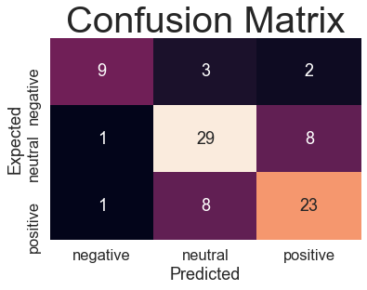
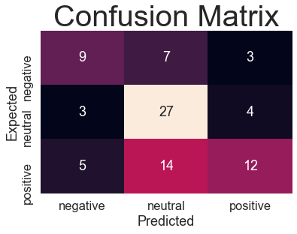
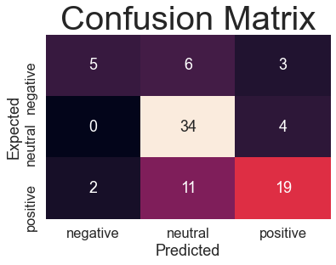
Comparison of Models
Logistic Regression
MLP
Random Forest

Slide 14
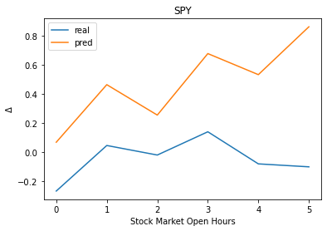
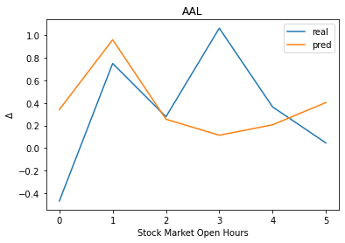
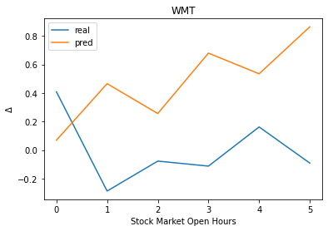
Financial Modeling

Slide 15
Results and Opportunities
Bert was the Best NLP model, followed by logistic regression.
Sentiment Analysis has potential for utility in trading applications.
Given More time, we would:
Create a streaming pipeline for real-time sentiment results.
Test the relationship between sentiment and price over a longer time-span.
Factor more features into the price regression
Experiment with alternative calculations of aggregate sentiment.
Ex: weighing accounts with lots of followers more heavily into hourly sentiment.

Slide 16


Thank you!
- Team 9

